Slide 1
Autonomous Detection of Regular Languages
Joel Sommer, Lingjing Huang

Slide 2
Question
Can a Neural Network determine if an input string is “in the language” of the regular language it was trained on?

Slide 3
Objectives
Train the Neural Network on a regular language
Test the Neural Network’s ability to identify whether or not “new” input strings are in the language or not in the language

Slide 4
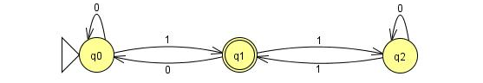
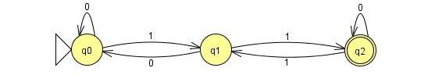
Sample Regular Language
dfa_0,000101
dfa_0,010001
dfa_1,111011
dfa_1,1000011

Slide 5
String Generation (Initial Approach)
For each DFA:
Start at the initial state
Randomly transition out of the state
Repeat random transitions until a minimum string length has been met
Check to see if the current state is the terminal state
Check to see if the current string is already in the overall list of strings
Check to see if the current string matches any other DFAs.

Slide 6
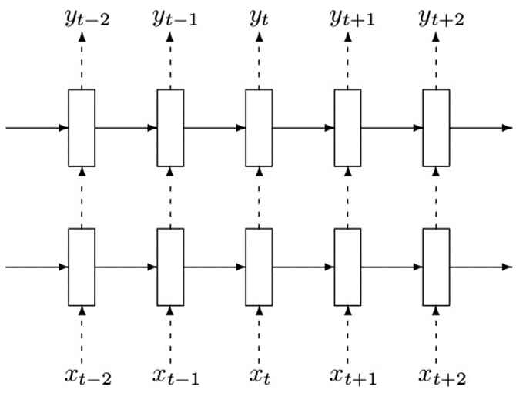
Neural Network Model (Overview)

Slide 7
Initial Approach
Reuse the RNN Example provided on: https://www.tensorflow.org/tutorials/recurrent
Overall tutorial uses a PTB (Penn Tree Bank) data set
Data set is a large natural language database
PTB example looks at the predicting the next word based on the probability of what has already been

Slide 8
Initial Approach
Natural language doesn’t have the same flow as Automata
Automata need to be able to transition on what are relatively arbitrary data points (compared to natural language)
There may be some sort of way to identify some sort of probabilistic association, but it doesn’t make sense in this context.

Slide 9
Revised Approach
Borrow heavily from:
F. A. Gers and E. Schmidhuber, "LSTM recurrent networks learn simple context-free and context-sensitive languages," IEEE Transactions on Neural Networks, vol. 12, no. 6, pp. 1333-1340, Nov 2001. Overall tutorial uses a PTB (Penn Tree Bank) data set
Gers and Schmidhuber employ “Peephole Connections” and “Forget Gates” to allow for feedback between the Neural Network cells.
Peepholes and Forget Gates are mixed into Constant Error Carousels (CECs)
The CEC in a cell allows the cell to accept and correlate correction from other cells within the neural network.

Slide 10
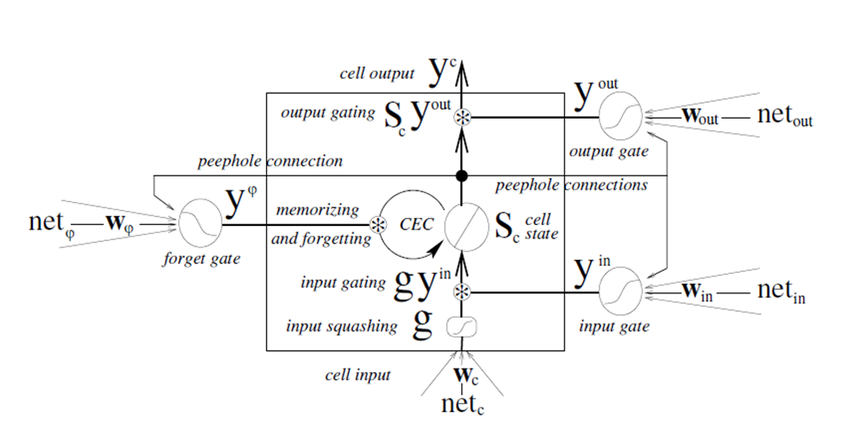
Neural Network Model (Single Cell)

Slide 11
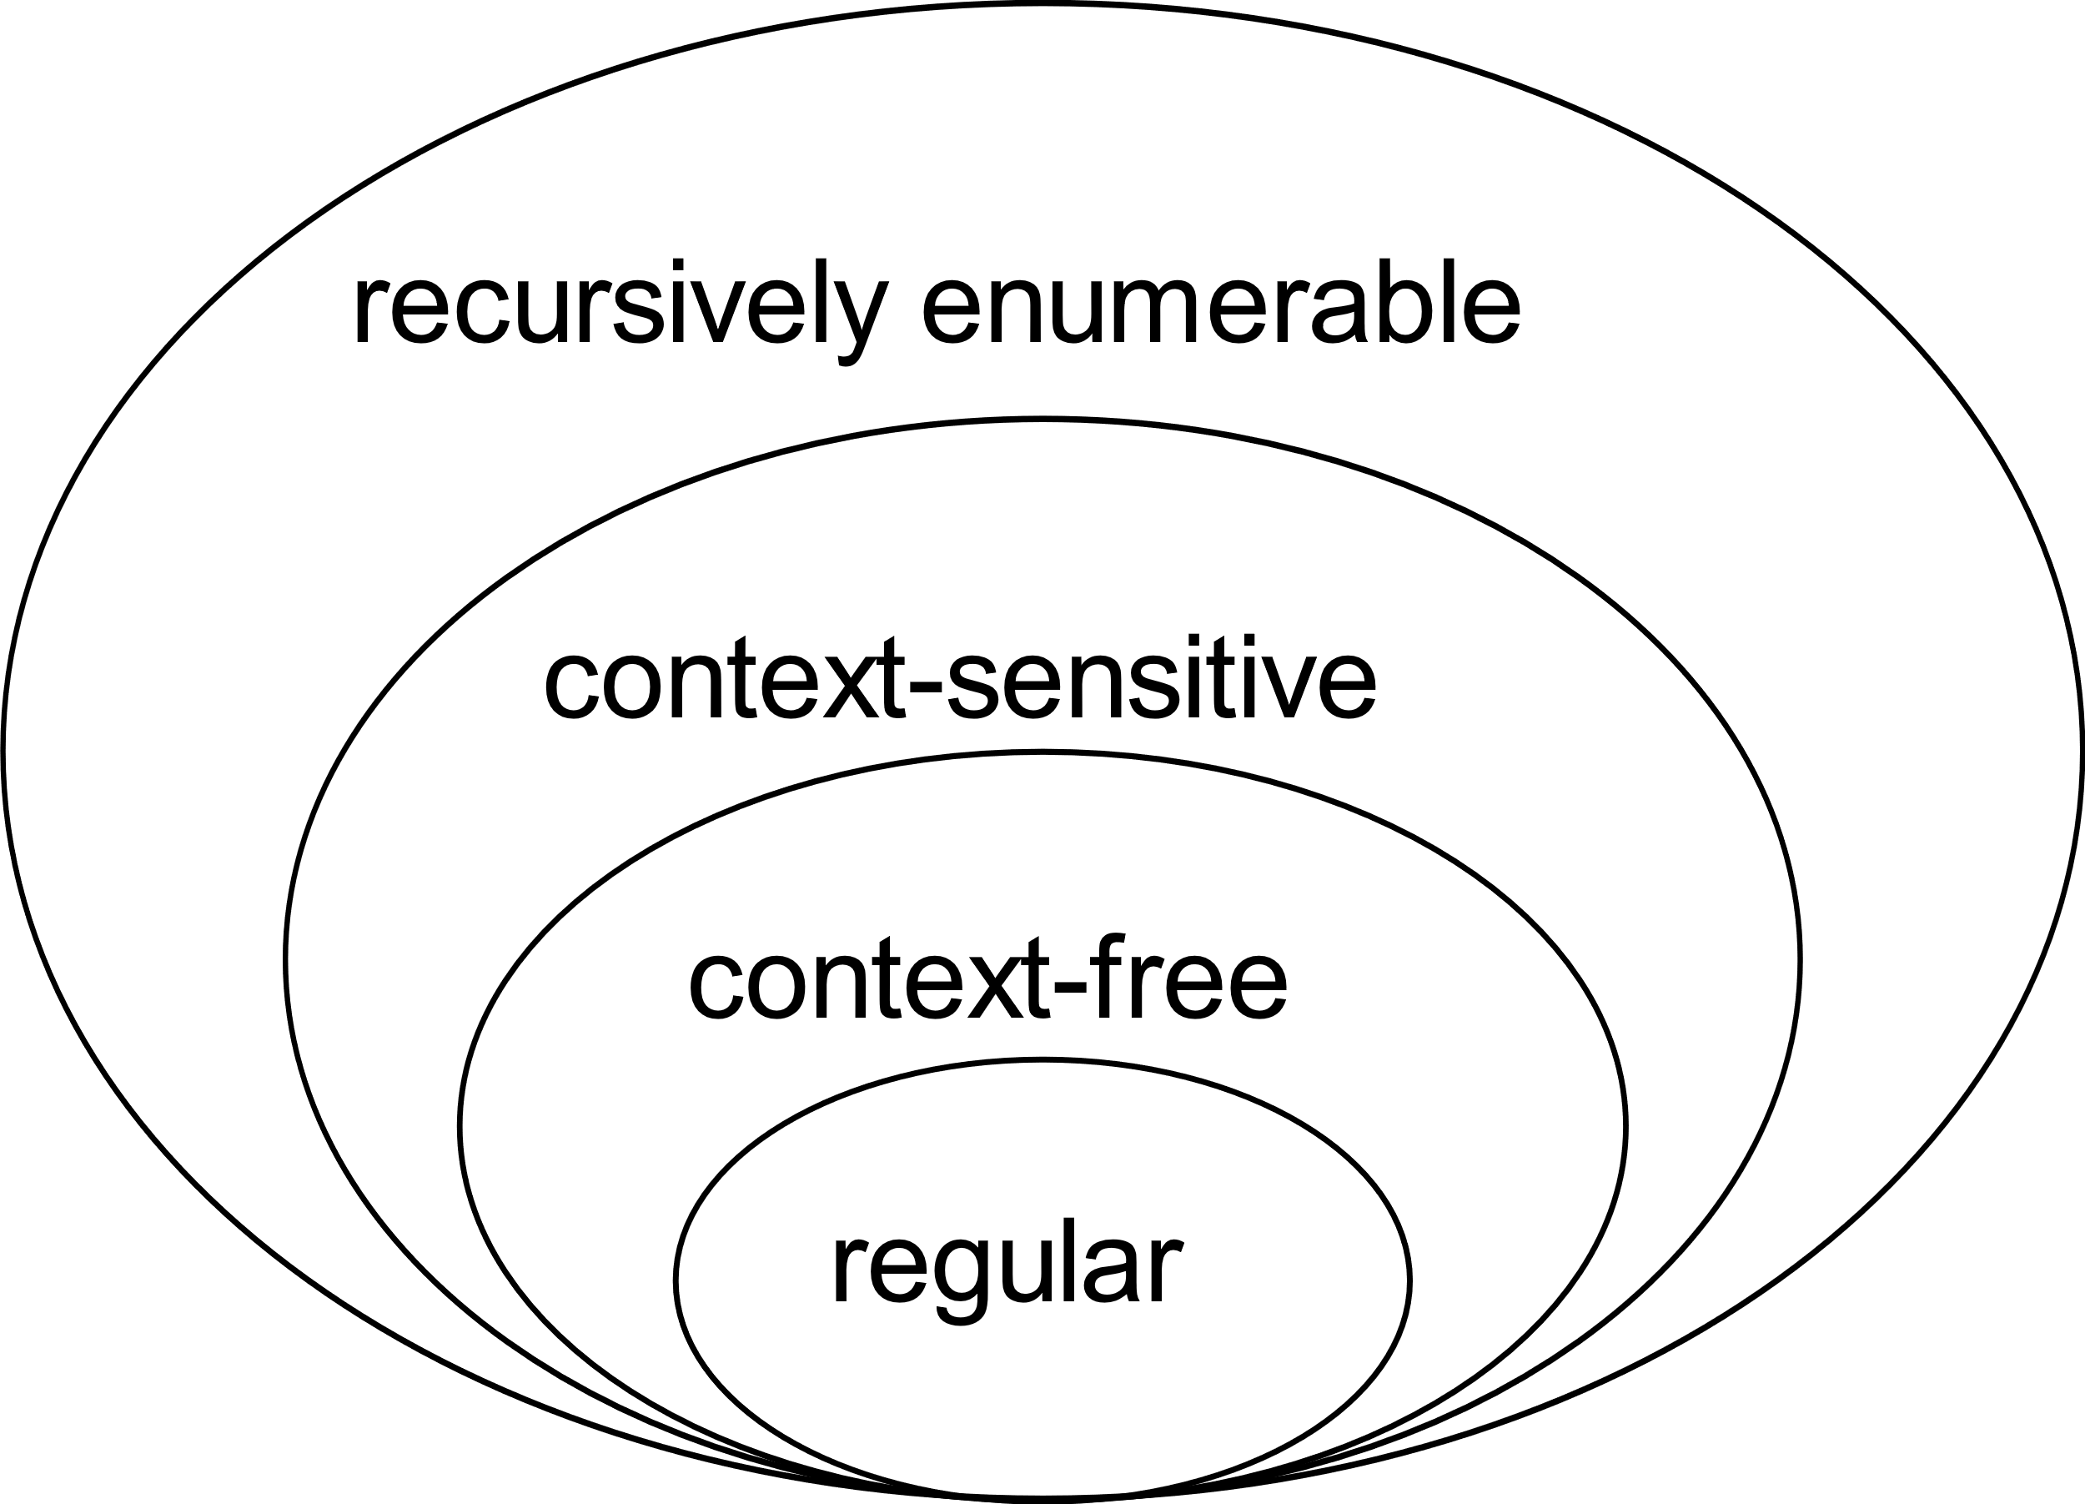
Revised Approach
Gers and Schmidhuber focused on CFL and CSL and found that they were able to have the Neural Net learn the language.
This suggests that there should be no issue with their approach learning a Regular Language
By J. Finkelstein - Own work, CC BY-SA 3.0, https://commons.wikimedia.org/w/index.php?curid=9405226

Slide 12
String Generation (Revised Approach)
Use a 32-bit word as a candidate string. All values from 0x0 – 0xFFFFFFFF were evaluated.
Convert each 32-bit word to a string literal of ones and zeros
Feed string literal to all DFAs. If only one DFA accepts the string, save the 32-bit word and label it as belonging to the accepting DFA.
This approach was taken to remove the variable string length aspect from developing the TensorFlow code.
Once the TF model is developed, the plan will be to go back to the variable length strings.

Slide 13
Questions?

